Slide 1

The Case of Urban Growth Boundaries
PPA Spring 2024
Week 5

Slide 2
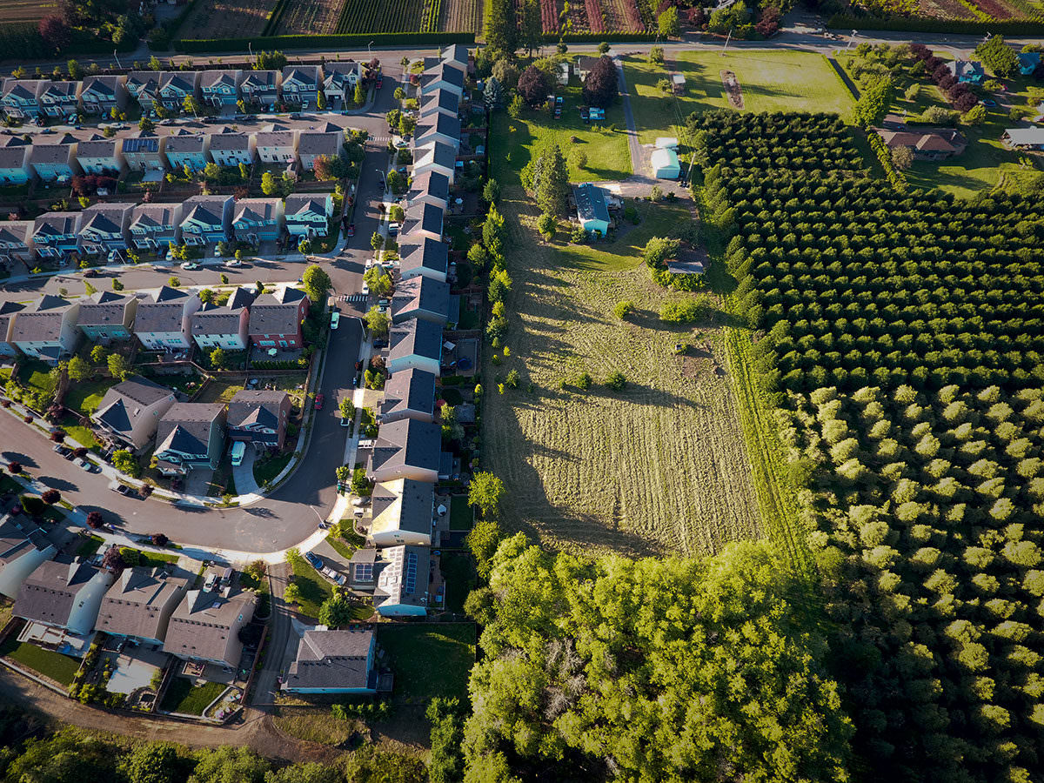
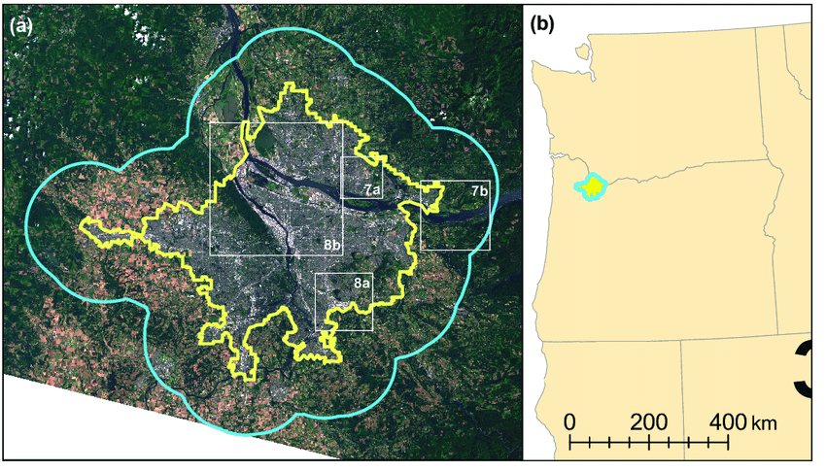
What are Urban Growth Boundaries?
Land use planning line to control urban expansion onto farm and forest lands.

Slide 3
“A tool that can be used to build upon and implement a comprehensive plan”
https://heinonline.org/HOL/Page?collection=journals&handle=hein.journals/tempnlt24&id=152&men_tab=srchresults

Slide 4
What is sprawl?
Disconnectivity, low density, car-centered
Why do we have sprawl?
Is it bad?

Slide 5
According to the APA…
UGBs should be established to “promote compact and contiguous development patterns that can be efficiently served by public services and to preserve or protect open space, agricultural land, and environmentally sensitive areas”

Slide 6
Furthermore…
They should include or permit existing or proposed land uses at densities and intensities sufficient to permit urban growth that is projected for the region for the succeeding 20-year period.

Slide 7
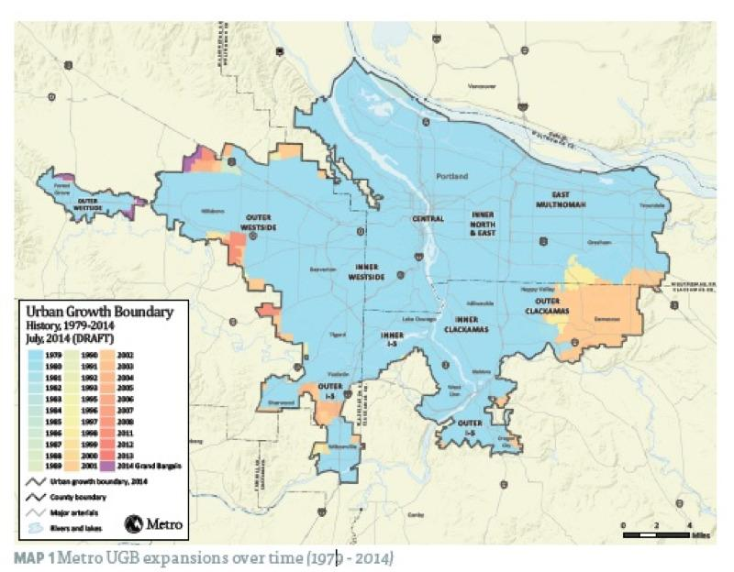

Slide 8
Tricky in Principle
Need a good population projection to determine the rate of urban development and how much land to include inside the boundary.
Too little → Land price inflation
Too much → Won’t prevent sprawl

Slide 9
Do they work?
Questionable:
Some find it has diverted growth (Portland, OR)
Increased densification (larger homes but smaller lots)
Higher land prices?

Slide 10
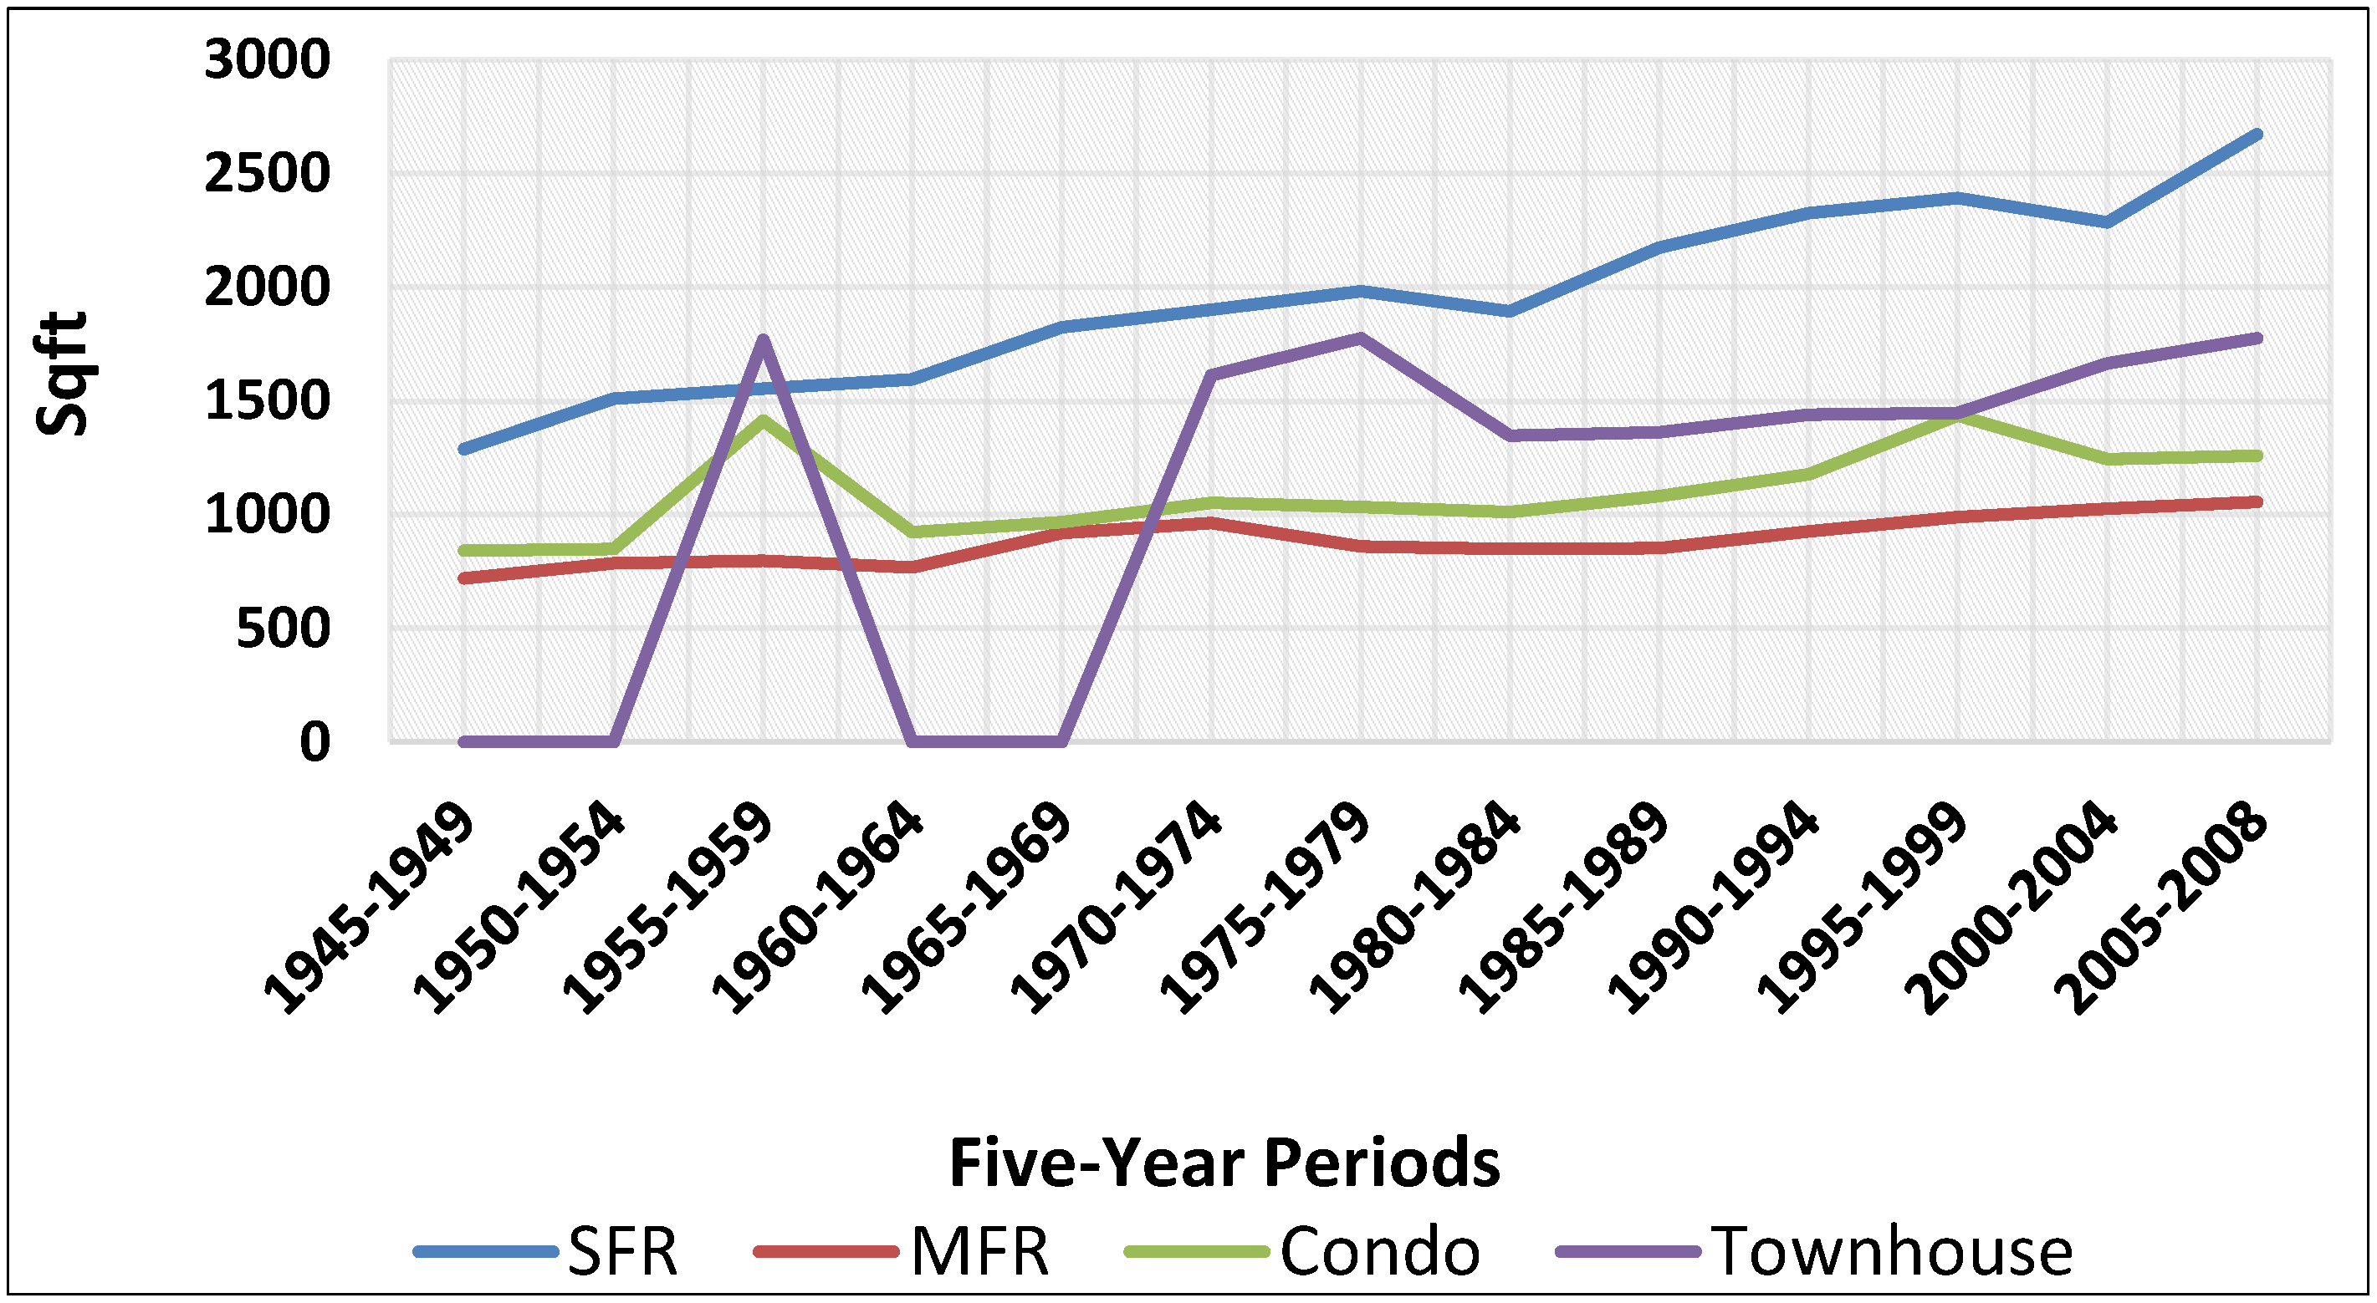
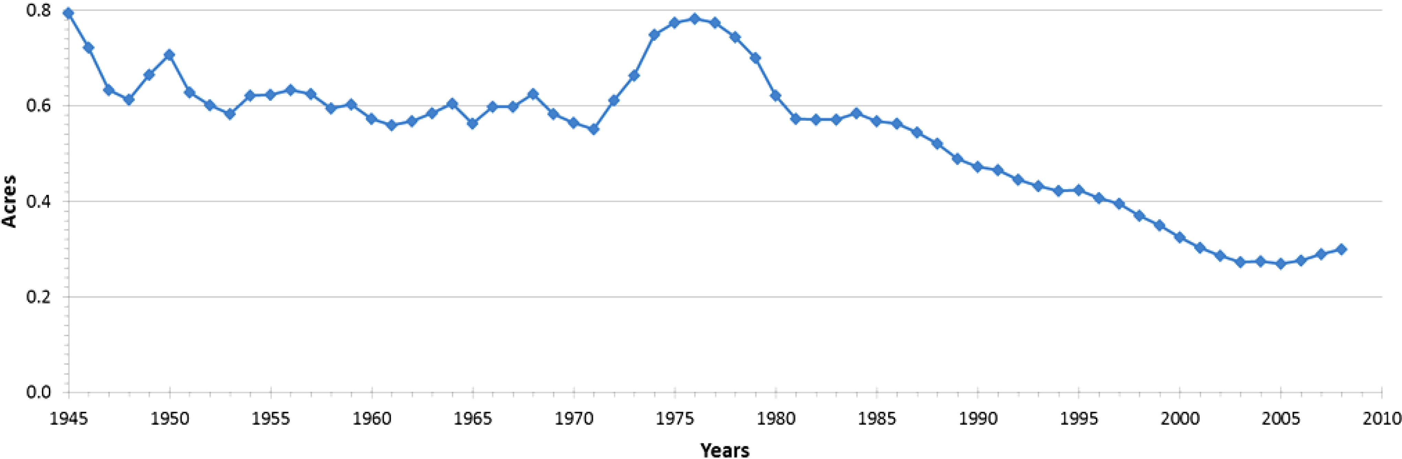
Sometimes Densification Happens without UGBs
https://www.mdpi.com/2071-1050/6/6/3975

Slide 11
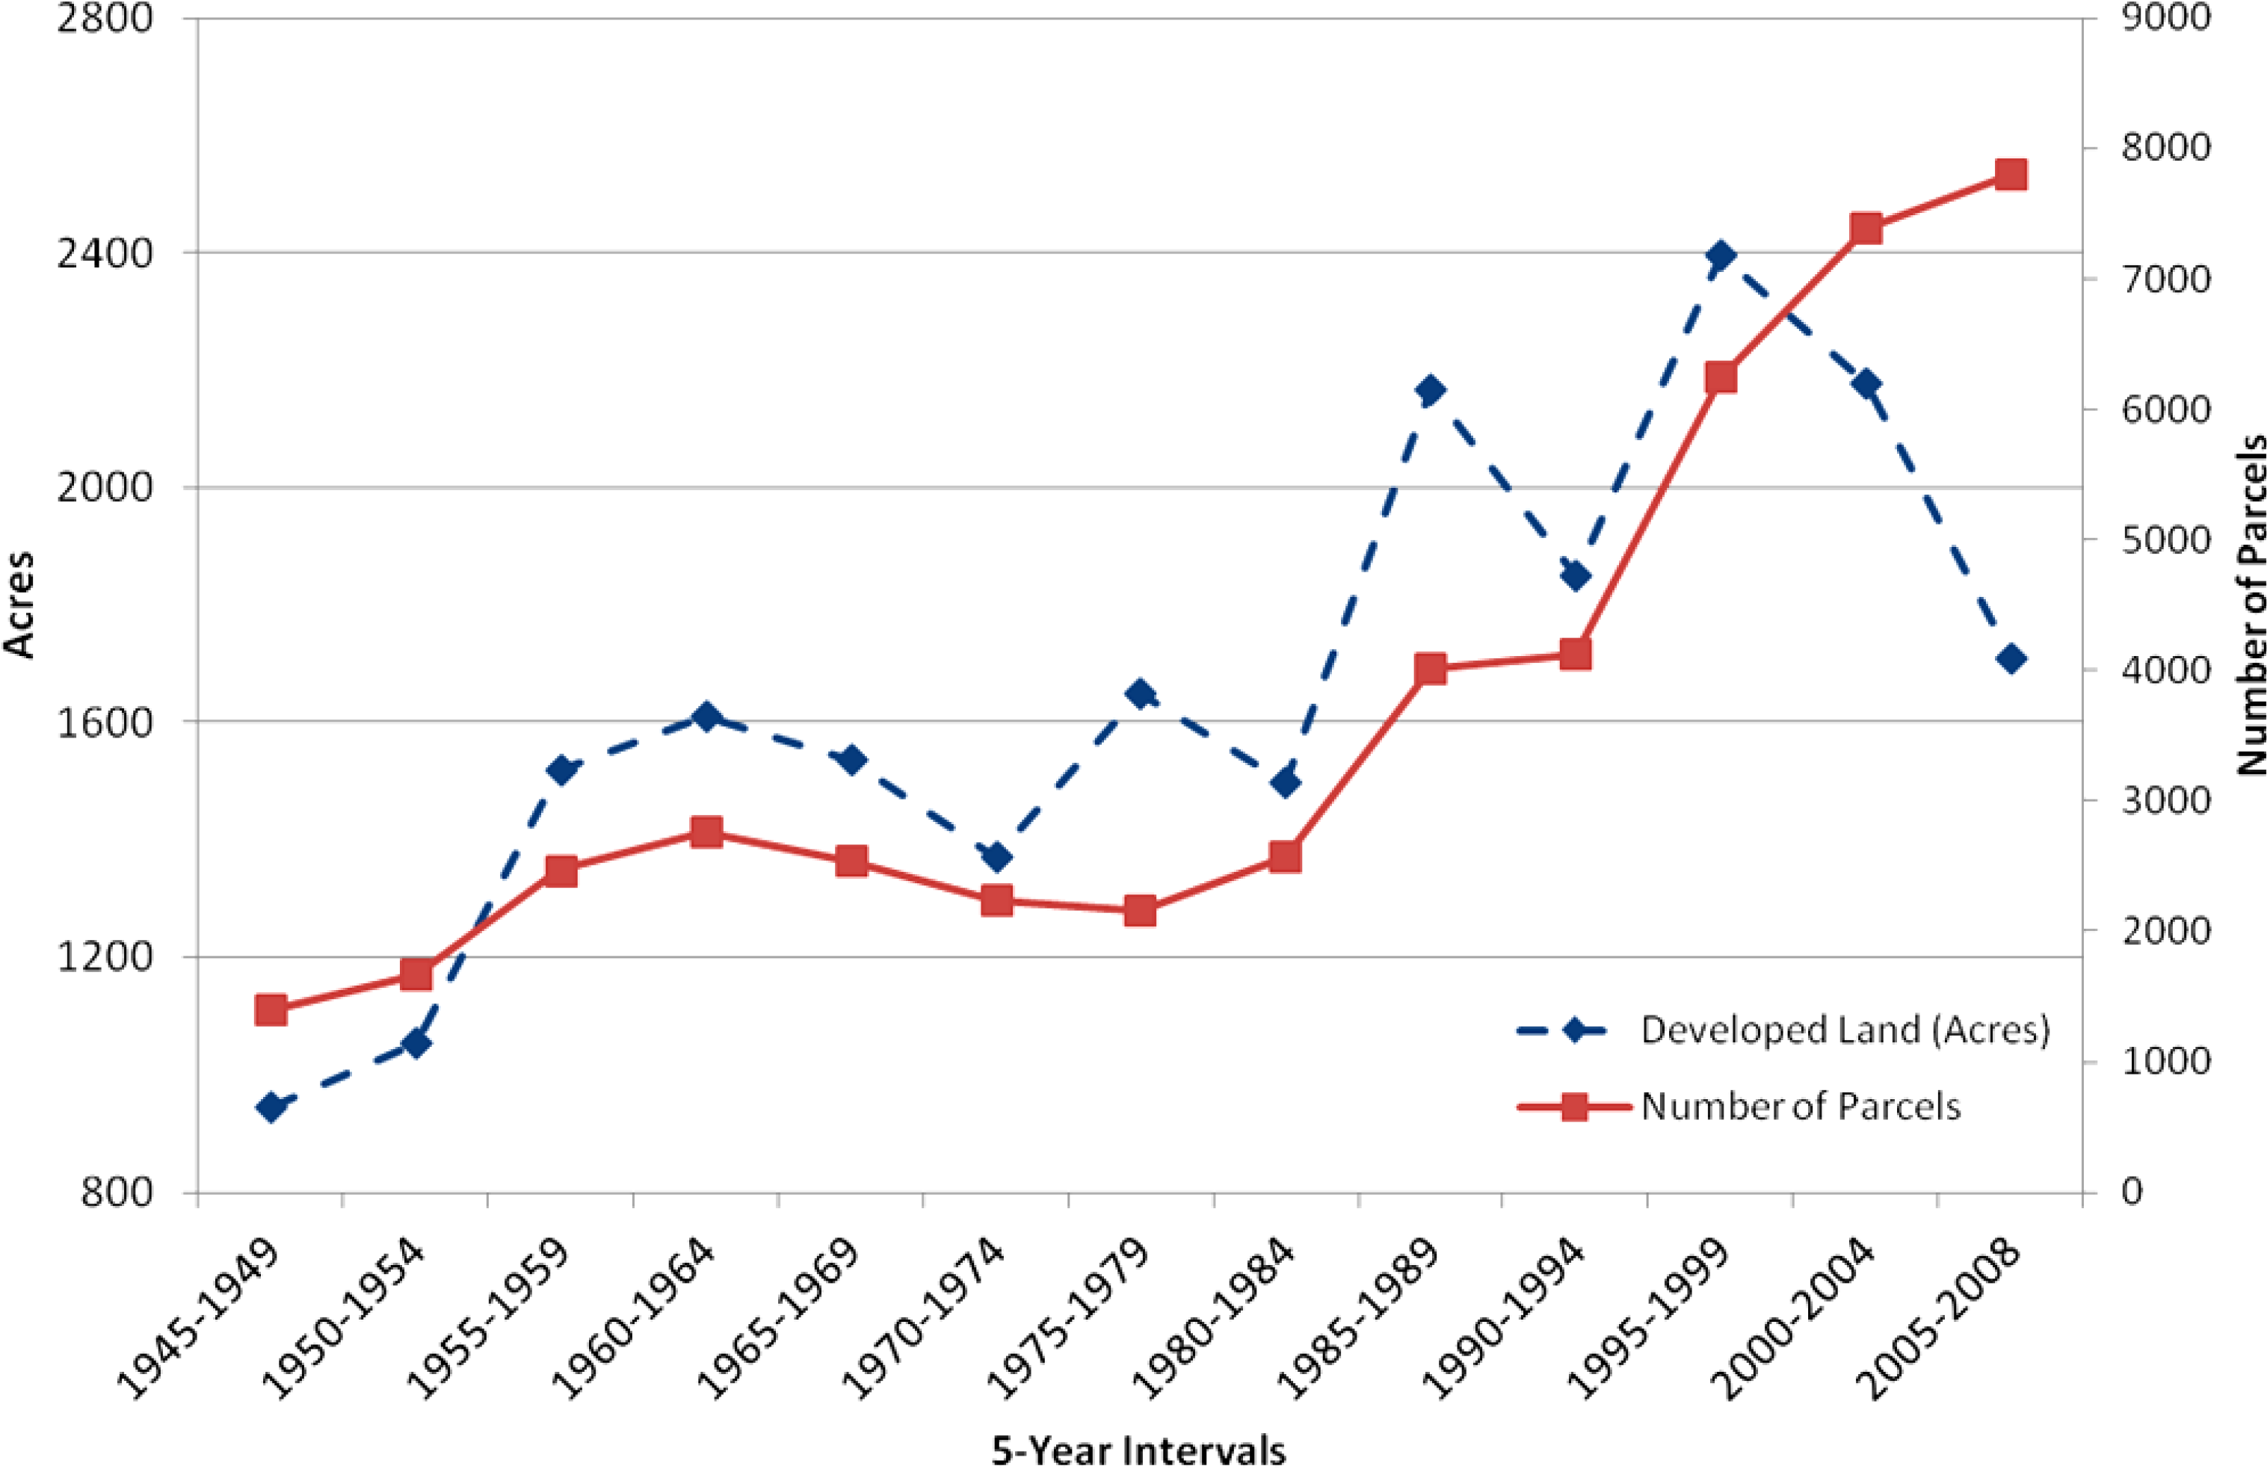

Slide 12
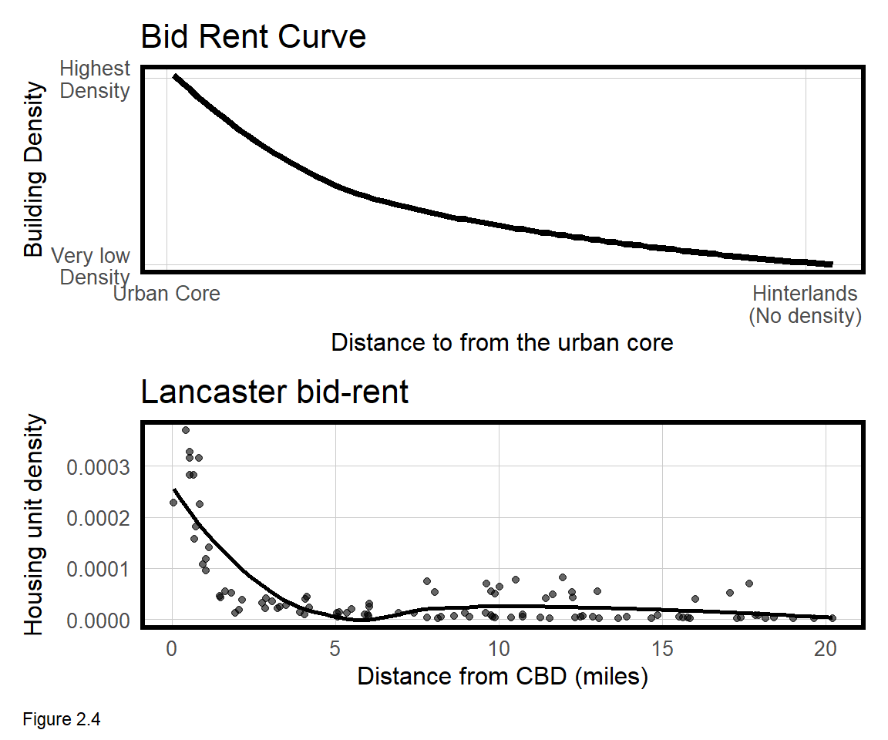
How can we evaluate the impact?
Bid-Rent Model
Why don’t we have skyscrapers in the suburbs?

Slide 13
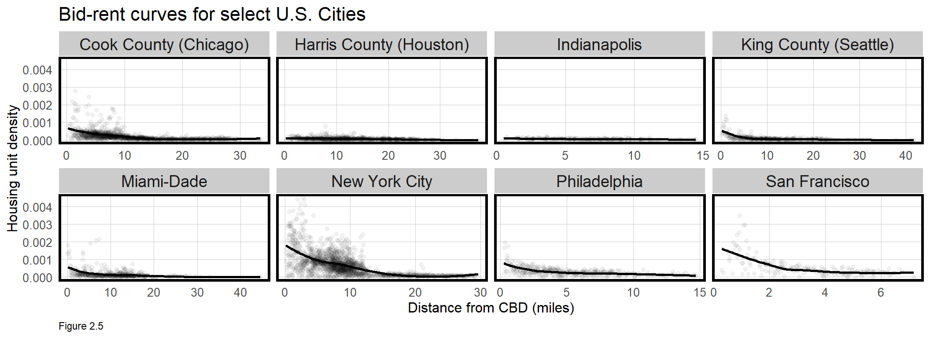

Slide 14
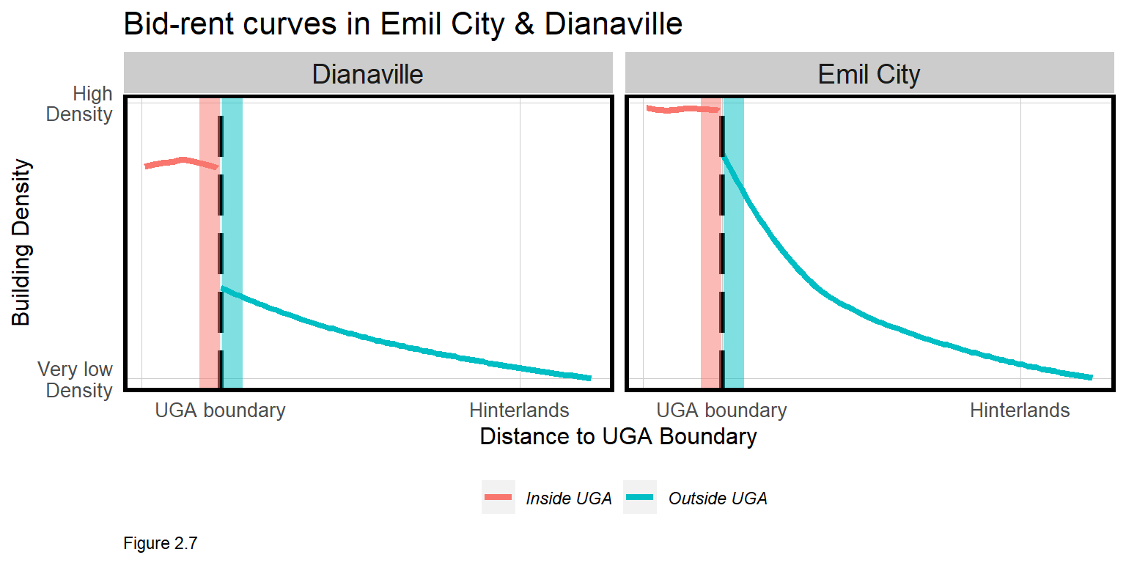
Evaluate Curves inside vs. outside boundary

Slide 15
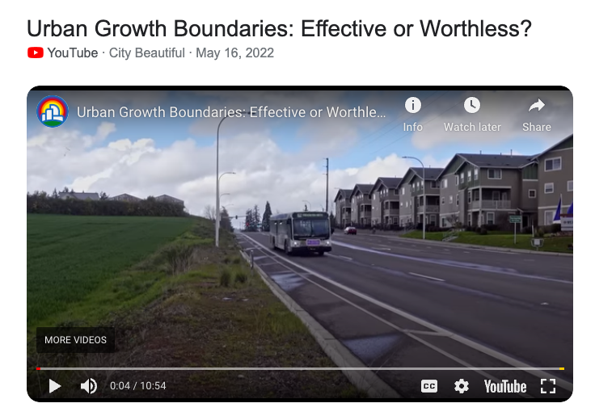
A nice summary
https://youtu.be/Gm-KrSqy1EM

Slide 16
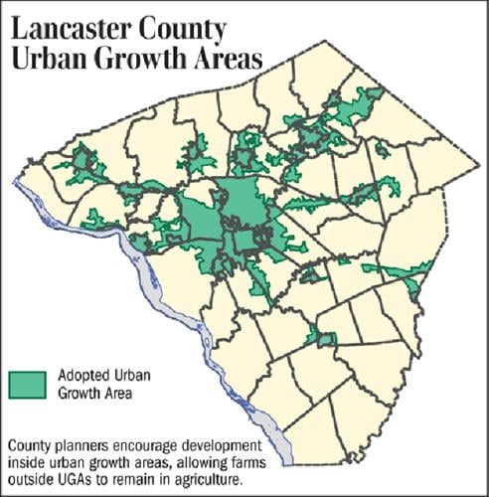
The Case of Lancaster, PA
1988 – Lancaster County named a “most endangered place”.
1993 – Lancaster County Planning Commission added growth management to its comprehensive plan.
1st County in PA to have growth boundaries.
But counties have no power to enforce land use laws.

